Slide 1


Dynamic Classification framework for Large Scale Data
Nikhil sharma Under Supervision of
MIT2020009 Dr. Manish Kumar

Slide 2
Outline
Introduction
Objective
Literature survey
Dataset
Methodology
Accuracy Measures
Result and Discussion
Conclusion
References

Slide 3
Introduction
Classification is the problem of identifying to which set of categories a new observation belongs.
Classification is considered an instance of supervised learning where a training set of correctly identified observations is available.
Nowadays the classification process can involve a huge amount of data.
The amount of data produced in the twenty-first century is rapidly expanding, and it shows no signs of slowing down any time soon.
Day by day the size of data is increasing so this type of data is called big data and we can say large-scale dataset.

Slide 4
Objective ?
Big Data is now a component of almost every industry like stock exchange, e-commerce, banking, and worldwide economic functions.
Efficient analysis of these types of dataset is required to obtain information from it and convert it into classified format.
So our task is to implement a dynamic classification framework and use some traditional approaches in this framework here we classified our data more abstractly, rather than a time-consuming and static method.
In this project, we used the Apache Py Spark framework to create a Pipeline , which consists of a series of Pipeline-Stages that can be run in parallel to reduce the time overhead.

Slide 5
Literature survey
Sr No | Papers | Summary | Advantage | Disadvantage
1. | Pietro & Michela et.al (2020) [2] | An overview of recent distributed algorithms for learning fuzzy models in Big Data classification. | Their complexity, in terms of number of rules or number of nodes of the fuzzy trees, is very high. | The limitations, of this is it’s create problems in dealing with small Dataset file.
2. | Abraham et.al (2019) [1] | Selecting a representative decision tree from an ensemble of decision-tree models for fast big data classification. | When we compare Sysm accuracy to similarity measures and combined distance, we can observe that Sysm is more accurate in most circumstances. | Scanning the tree takes lots of time.

Slide 6
3. | Francisco & Sebastián(2019) [3] | Evaluating associative classification algorithms for Big Data. | In Big Data, very comparable results have been produced. | Sometime loss of important information.
4. | Begum & Deniz (2019) [4] | Comparison of Data Mining Classification Algorithms Determining the Default Risk. | Credit risks are identified and the possibility of default is estimated using these methods. | Time complexity is more because run so many method.
5. | S.Sukumaran et.al [5] | A study on classification techniques in data mining. | There is at least one method that works perfectly for just about every data set. | No single classification algorithms is best for all kind of dataset.

Slide 7
6. | Qi Jia & Linke Guo (2016) [8] | Privacy-preserving Data Classification and Similarity Evaluation for Distributed Systems. | Identifying the most closely matched group of users with the most comparable interests or activities. | It's costly and a little bit time consuming.
7. | S.Sukumaran et.al (2013) [5] | A study on classification techniques in data mining. | There is at least one method that works perfectly for just about every data set. | No single classification algorithms is best for all kind of dataset.
8. | Dorota (2010) [9] | Classification and Meta Classification in Large Scale Data Mining Application for Estimation of Software Projects. | Meta classifiers hold the promise of improving estimation accuracy. | Analyze is not the same as the dynamics of a simulated process, which could result in a lack of comprehension and ineffective decision assistance.

Slide 8
Dataset
We used data Home_Quote_Conversion from Kaggle [11] this dataset represent the activity who are interested in buying policies from Homesite.
In this Dataset 173837 rows and 272 columns and QuoteConversion_Flag indicates whether the customer purchased a policy or not and the task is to predict QuoteConversion_Flag for each QuoteNumber in the test set.

Slide 9
Methodology
1. Logistic Regression:- Logistic regression used the logit function for probability prediction.
2. Decision Tree:- To form a group, this algorithm finds the most significant independent variable.
3. Random Forest:- This algorithm creates numerous decision trees and merges them together into a single decision Tree and use bagging method.
4. Gradient Boosting The boosting ensemble technique is used in this approach. The reasoning behind this strategy is that successive predictors learn from the mistakes of prior predictions.

Slide 10
Accuracy Measures
 | Logistic Regression | Decision Tree | Random Forest | Gradient Boosting
Accuracy | 0.89 | 0.88 | 0.84 | 0.91
Sensitivity | 0.56 | 0.36 | 0.17 | 0.56
Specificity | 0.97 | 1.00 | 1.0 | 0.1
Precison | 0.81 | 1.00 | 1.0 | 0.97
GINI | 0.78 | 0.72 | 0.82 | 0.89
Log Loss | 0.2821 | 0.2929 | 0.3317 | 0.2402

Slide 11
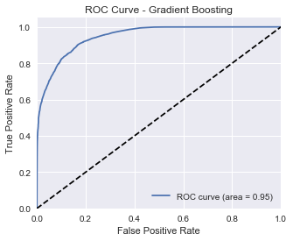
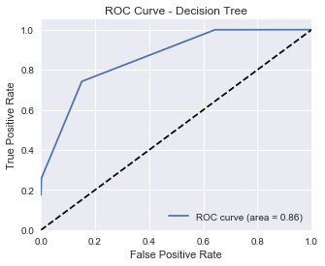

Slide 12
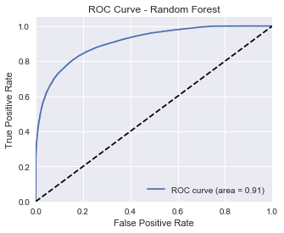
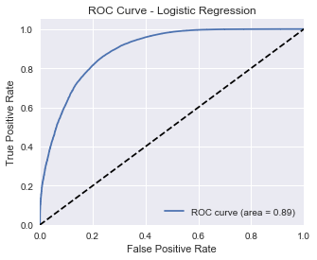

Slide 13
Result and Discussion
We compare the result on all the measures for better method selection like accuracy, sensitivity, specificity, precision (Proportion of positive cases), GINI and log loss.
Here we give first priority to accuracy then sensitivity then precision then specificity then GINI and at the end log loss.
With the help of these measures and priority we go with top two models from four options and then apply them to a data test in term of accuracy logistic regression and gradient boosting give best result.

Slide 14
Conclusion
After all the accuracy comparison now we know which model gives us the best evaluation prediction for the given dataset and we say it is the ideal model for predicting the results of our data test.
Here we can select the top two models from four options and then apply them to a data test. To predict this scenario, I used Logistic Regression and Gradient Boosting.
But when we used some other dataset then scenario may change according to dataset because it’s work on a dynamic framework it’s select always the best possible models for the given data set.

Slide 15
References
[1] Abraham Itzhak Weinberg and Mark Last “Selecting a representative decision tree from an ensemble of decision‑tree models for fast big data classification” Journal of Big Data volume 6,Article number: 23 (2019).
[2] Pietro Ducange, Michela Fazzolari and Francesco Marcelloni “An overview of recent distributed algorithms for learning fuzzy models in Big Data classification” Journal of Big Data volume 7,Article number:19 (2020).
[3] Francisco Padillo, José María Luna and Sebastián Ventura “Evaluating associative classification algorithms for Big Data ” Big Data volume 7,Article number:19 (2019).
[4] Antonio J. Peña, Begum Çıgsar and Deniz Unal (2019) “Comparison of Data Mining Classification Algorithms Determining the Default Risk” Volume 2019 | Article ID 8706505.

Slide 16
[5] S.Sukumaran,G. Kesabaraj “A study on classification techniques in data mining.” 2013 Fourth International Conference on Computing, Communications and Networking Technologies (ICCCNT).
[6] Liu B, Hsu W, Ma Y. “Integrating classification and association rule mining.” In: 4th International Conference on Knowledge Discovery and Data Mining(KDD98).
[7] H. Wang, Y. Gao, Y. Shi and H. Wang, "A Fast Distributed Classification Algorithm for Large-Scale Imbalanced Data," 2016 IEEE 16th International Conference on Data Mining (ICDM), Barcelona, 2016.
[8] Q. Jia, L. Guo, Z. Jin and Y. Fang, "Privacy-Preserving Data Classification and Similarity Evaluation for Distributed Systems," 2016 IEEE 36th International Conference on Distributed Computing Systems (ICDCS), Nara, Japan, 2016.

Slide 17
[9] D. Dzega and W. Pietruszkiewicz, "Classification and meta classification in large scale data mining application for estimation of software projects," 2010 IEEE 9th International Conference on Cyberntic Intelligent Systems, Reading, UK, 2010.
[10] H. Zou and Z. Jin, "Comparative Study of Big Data Classification Algorithm Based on SVM," 2018 Cross Strait Quad-Regional Radio Science and Wireless Technology Conference (CSQRWC), Xuzhou, China, 2018.
[11] https://www.kaggle.com/c/homesite-quote-conversion.

Slide 18
Thank You

